Slide 1


On Board –Product Development

Slide 2
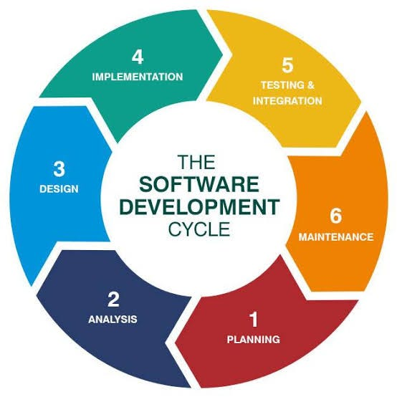
SDLC Fundamentals
Required Software and Tools
Git,Node.Js,MongoDb, Vs Code Editor and Postman.
Jira Process and Figma.

Slide 3
HTML,CSS and JavaScript
HTML
CSS
JavaScript
standard markup language.
Elements and Tags.
Browsers use HTML tags to render the content of the page.
Inline CSS
<p style="color: blue;">This is blue text.</p>
Internal CSS
<style> p { color: blue; } </style>
External CSS
<link rel="stylesheet" href="styles.css">
Open-source programming language.
Key Features of JavaScript
Cross-platform compatible.
Integration with other backend and frontend technologies.

Slide 4
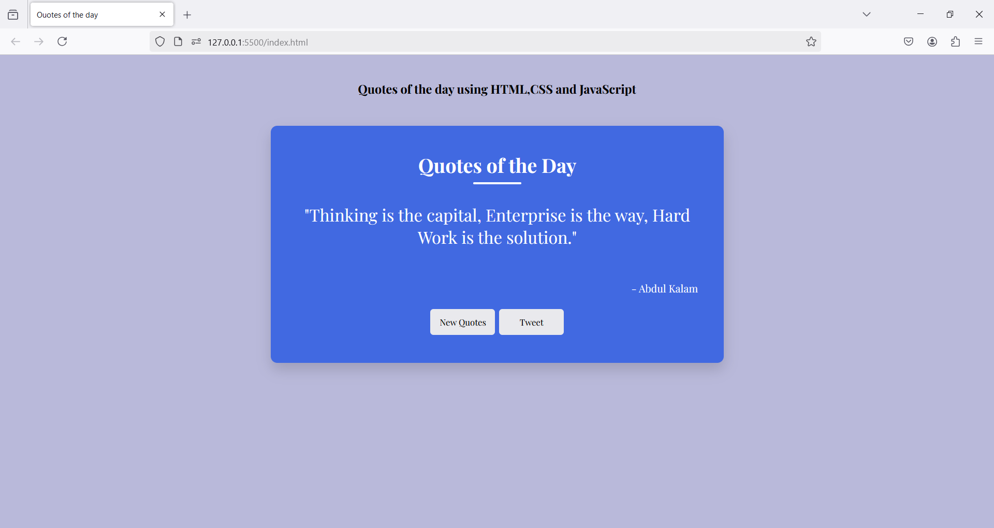
Assessment 1
Quotes of the Day using HTML,CSS and JavaScript

Slide 5
React
A JavaScript library for building user interfaces.
Features
Components.
JSX.
State and Props.
Virtual DOM.

Slide 6
Material UI and Responsiveness
A popular React component library.
Provides pre-styled and customizable components.
Theme Customization.
Responsiveness
Grid.
Breakpoints.
useMediaQuery.

Slide 7
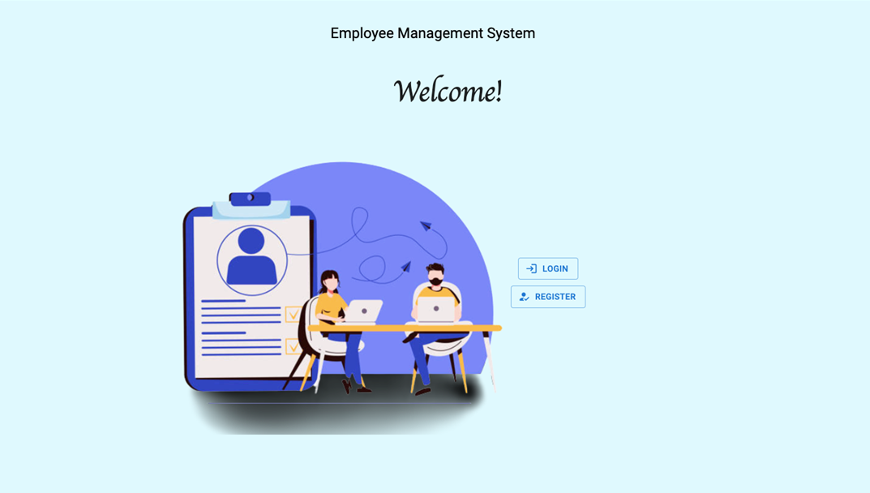
REACT Assessment 2

Slide 8
Database
A database is an organized collection of data stored in a computer system and usually managed by a database management system (DBMS).
Commonly Used Database
Relational (MySQL, Oracle and PostgreSQL)
NoSQL(MongoDB, Cassandra and DynamoDB)

Slide 9
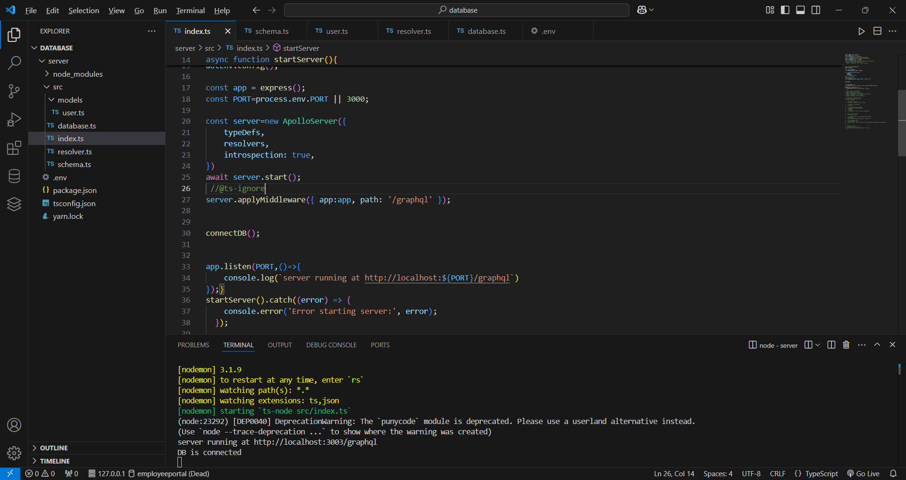
Database Setup and Assessment 3
What is MongoDB?
NoSQL database.
JSON.
Ability to handle unstructured data.
Why Choose MongoDB?
Ease to Use.
Flexible Data Model.
Real-Time Applications.

Slide 10
Backend Development
What is API?
API stands for Application Programming Interface.
GraphQL
Open-source query language and runtime for APIs.
Schema.
Single Endpoint.
Mutations.

Slide 11
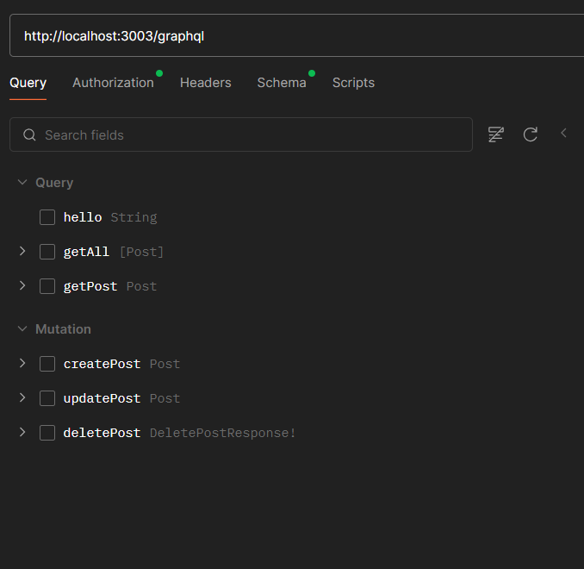
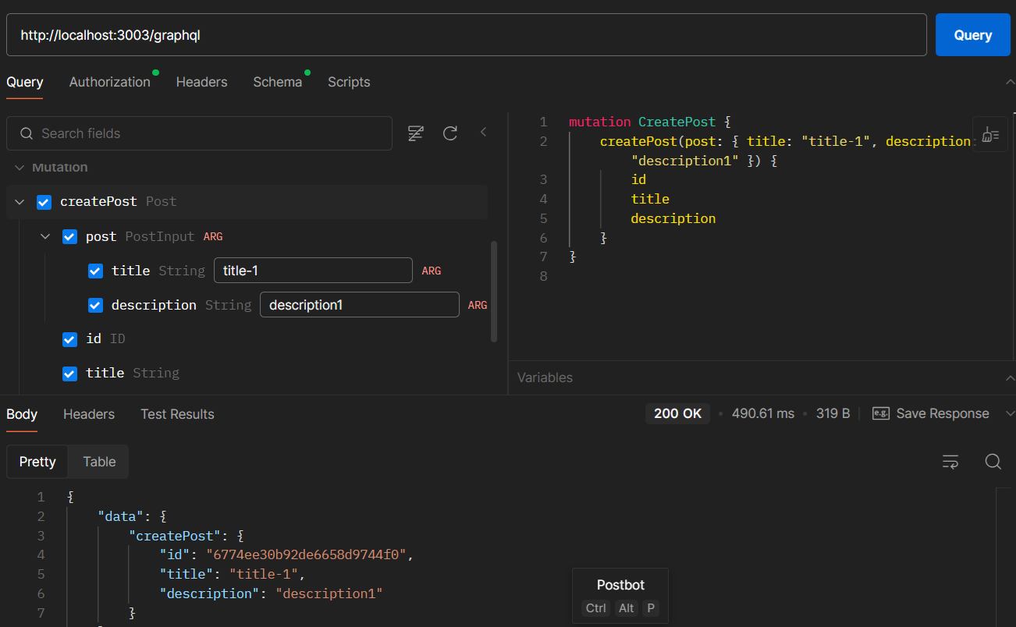
CURD Operation using Graphql

Slide 12
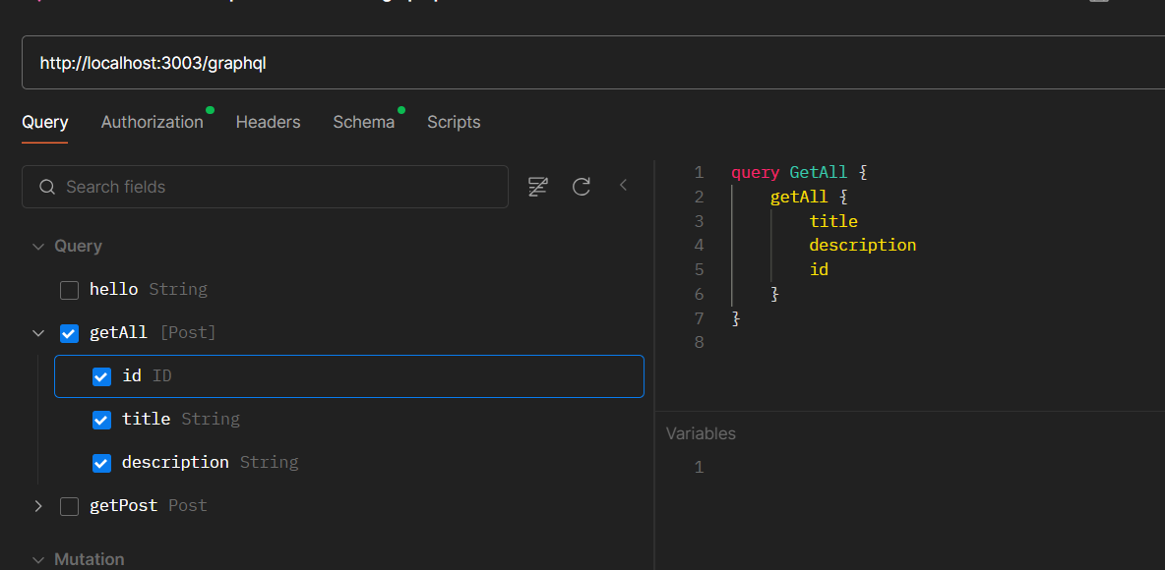
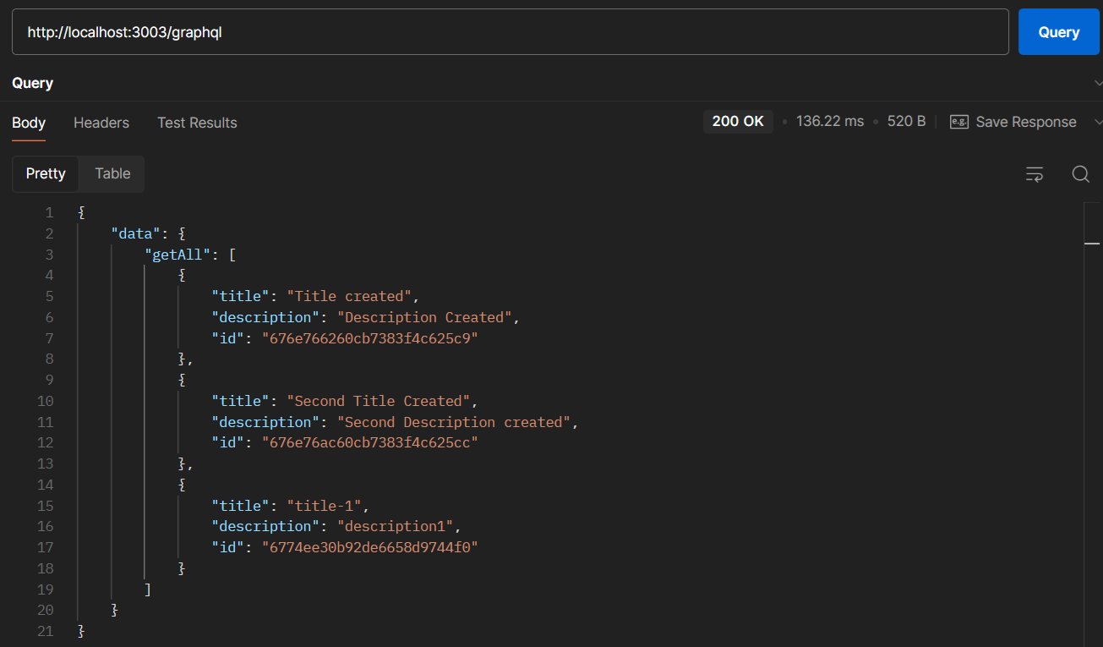
CURD operation

Slide 13
Authentication and Authorization
Authentication is determining whether a given user is logged in, and subsequently determining which user someone is.
Authorization is then determining what a given user has permission to do or see.
JSON web tokens.

Slide 14
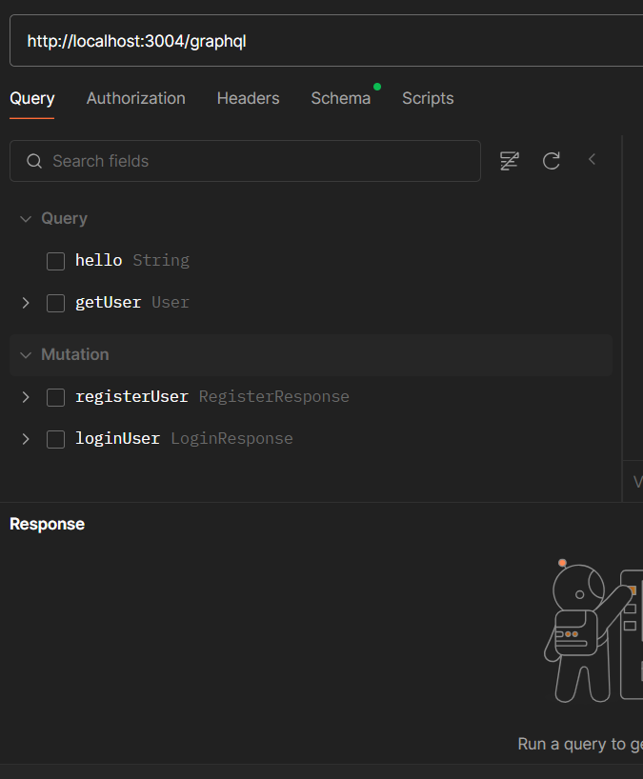
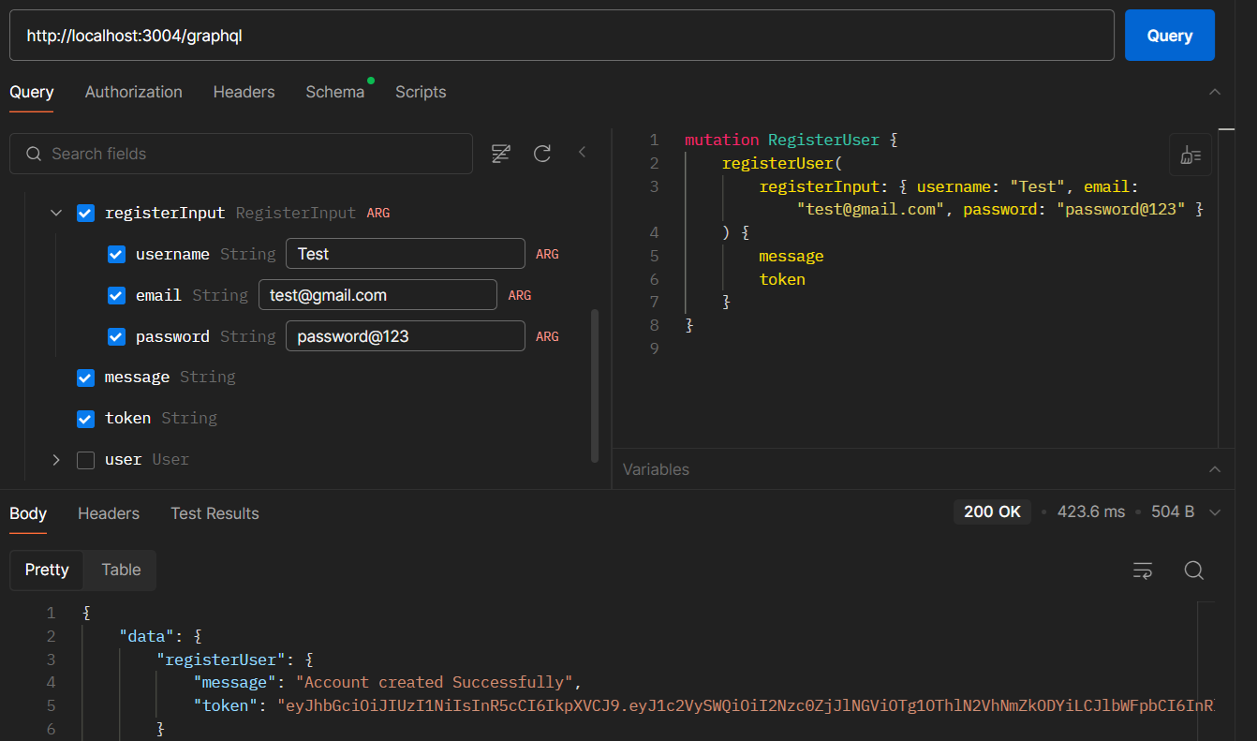
Register the user Details

Slide 15
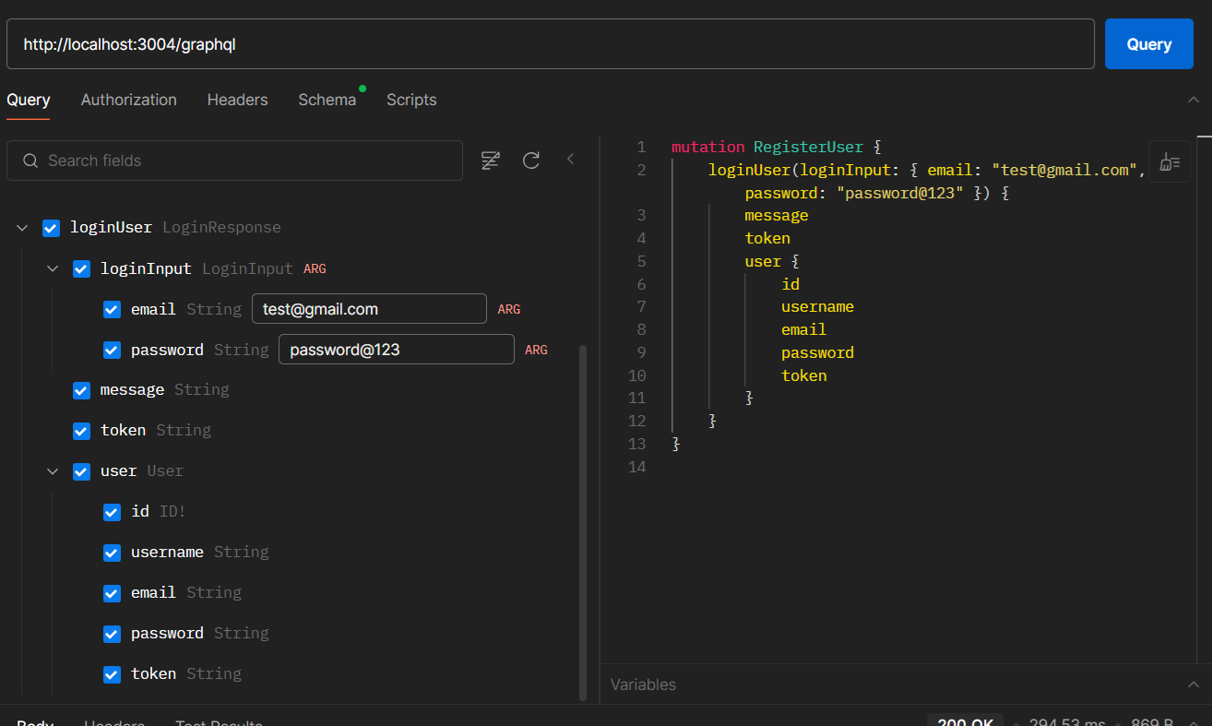
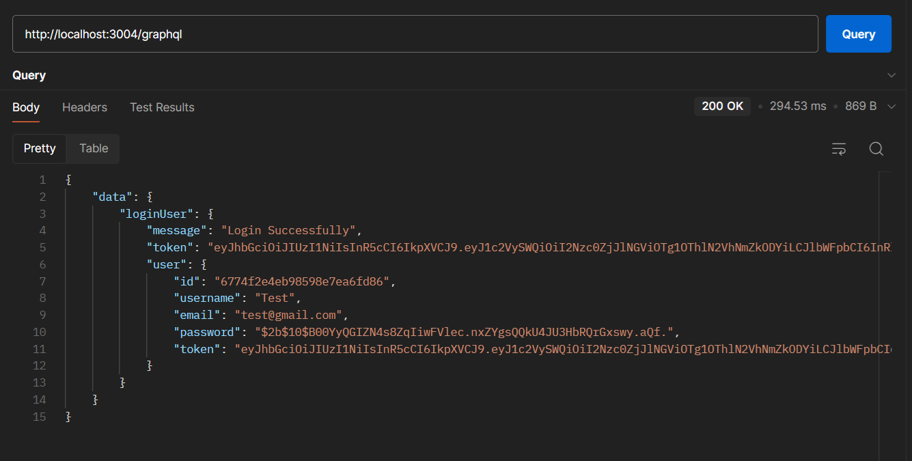
Login registered user

Slide 16
Frontend and Backend integration
Frontend Setup - React + Apollo Client
Makes requests from frontend to backend GraphQL API.
Manages state and cache.
Use useQuery for fetching data.
Use useMutation for performing CURD operation
Backend Setup - Apollo Server + MongoDB
Schema and resolvers.
Handles GraphQL queries and mutations.
Use Mongoose for interacting with MongoDB.
Implement CRUD operations in GraphQL resolvers.

Slide 17
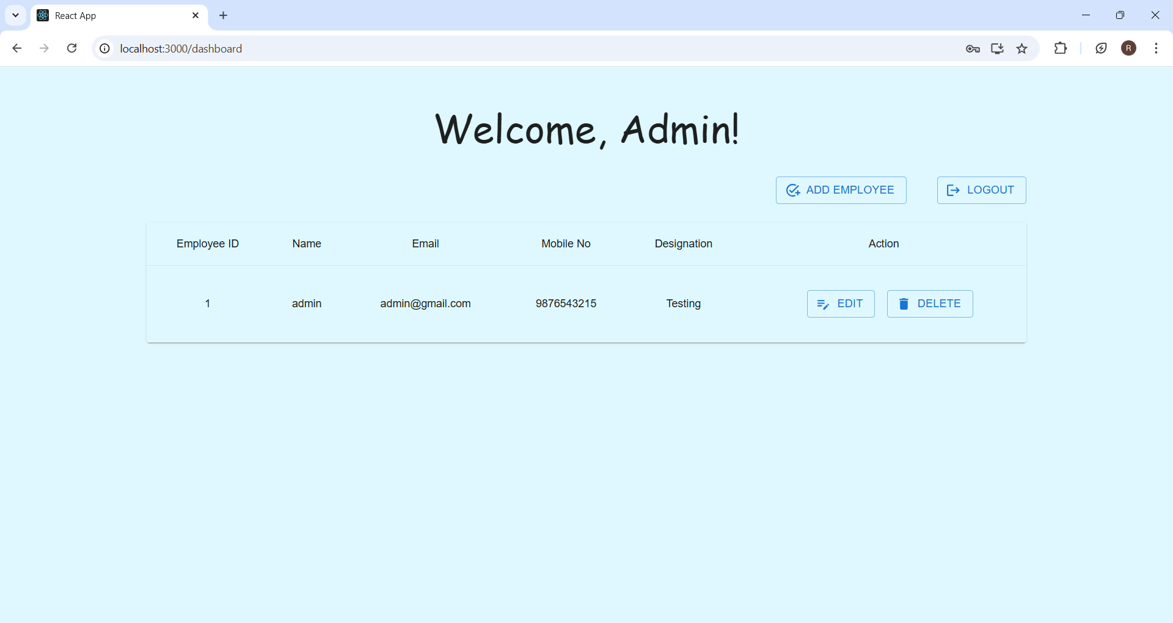
Final Demo

Slide 18


